Slide 1
literature review: Refactoring for disclosing code smells
MF1833061 沈思远
Notes:
就是针对代码异味进行重构的一个综述

Slide 2
Outline
Introduction
Categorization of code smells
Code smells detection approaches
Conclusion
Notes:
首先介绍下什么是代码异味以及对代码以为进行了分类介绍，然后介绍几类消除代码异味的方法，最后进行总结

Slide 3
Introduction
Code smells are violations of coding design principles. They increase technical debt, affecting software maintenance, and evolution. They contribute negatively to software understanding and potentially lead to the introduction of flaws.

Slide 4
Categorization of code smells
Bloaters
Long Method, Large Class
Object-Orientation Abusers
Temporary Field, Refused Bequest
Change Preventers
Divergent Change, Shotgun Surgery
Dispensables
Lazy class, Data class
Encapsulators
Message Chains and Middle Man
Couplers
Feature Envy and Inappropriate Intimacy
Others
Incomplete Library Class and Comments
Notes:
Bloaters:对应于代码的膨胀结构，比如：长方法、大类
Object-Orientation Abusers：对应与代码没有使用正确的面向对象编程的原则，比如类中存在临时字段和被拒绝的馈赠（子类并不想继承超类的所有函数和数据）
Change Preventers：对应于维护代码时需要在不同的类中修改，或者新增功能时需要修改很多函数
Dispensables：代码中存在冗余元素，比如纯数据类
Encapsulators 由于面向对象的特性需要对代码进行封装，封装往往意味着委托，即需要调用其他类的现有方法进行功能实现，但是人们可能过度使用委托，导致了过长的消息链，这样一旦调用链中的对象间关系发生变化，代码会不得不作出修改
Couplers：比如说依恋情结：一个函数跟另一个模块中的函数或者数据交流格外频繁，远胜于在自己所处模块内部的交流
Others：注释有时候过长往往是因为需要解释code smell，Incomplete Library Class 指的是封装好的类库中没有需要的函数

Slide 5
Code smells detection approaches
Manual detection techniques
Visualization based techniques
Semi-automatic techniques
Automatic detection techniques

Slide 6
Manual detection techniques
Human intervention for code smells detection
Tedious and time consuming
Munro suggested a template driven model to detect anti-patterns. The template consisted of three components: Name of smell, description of the properties of code smell in text format, Heuristics for the detection of smells
Give the possible location of bad smells based on the informal descriptions given by the originators Fowler and Beck

Slide 7
Visualization based techniques
Visualization orientated strategy, Visualized design defect detection strategy, Domain Specific Language
Simon suggested a powerful technique to inspect the internal quality of the software using a metric based visualization approach
Put together what belongs together
move function, move attribute, extract class and inline class
Notes:
将交流比较密切的放在一起其实就是 高内聚，低耦合

Slide 8
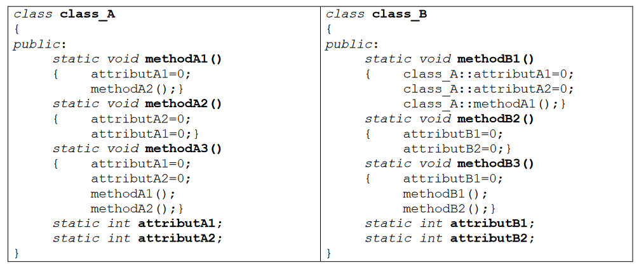
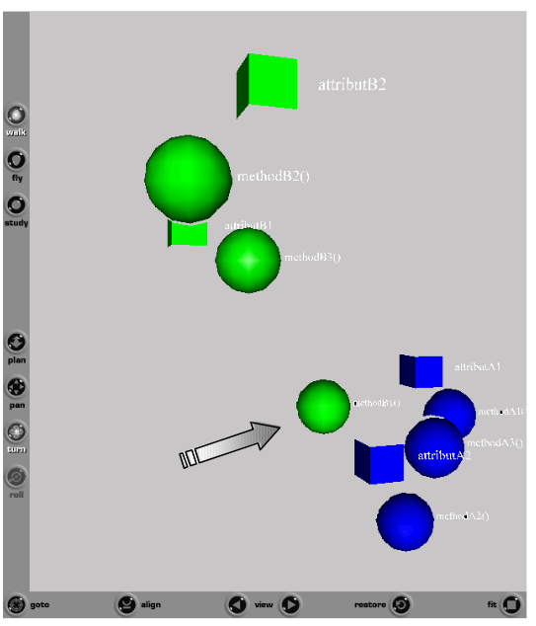
Visualization based techniques
Move methosB1 to class_A

Slide 9
Semi-automatic techniques
Semi-automatic strategy for the detection of smells
Liu et al. proposed a new kind of semi-automatic generalization refactoring approach where the classes and interfaces supporting inheritance were managed.
Notes:
泛化重构的方式（重组面向对象的源代码以最大利用泛化的能力），

Slide 10
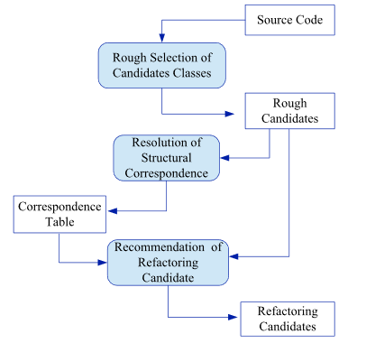
Semi-automatic techniques
GenReferee
Rough selection
Resolution of structural correspondence
recommends a list of refactoring opportunities
root classes
sibling classes
unrelated classes
offspring of the same ancestor
Notes:
首先对于不同类组成的类对经过粗略的选择形成候选类对
然后计算类对中类与类结构上的相似性，然后对于相似程度较大的类根据继承关系分为不同的类别
Root class：c1和c2无除了Object类外无共同祖先，那么可以设计一个新的父类包含两个类的共同行为，然后进行继承
Sibling class；两个类有相同的直接父类，那么可以把相同的成员变量或函数进行上移
unrelated classes：两个类的直接父类均不是Object类且不相同，这时候可以将它们的共同行为封装成一个接口
offspring of the same ancestor：两个类有非父类的相同祖先，也是将相同方法进行接口的封装

Slide 11
Automatic detection techniques
Marios suggested automatic refactoring of extract method based on complete computation slice and object state slice.
identify the design defects which affected coupling and cohesion in the form of Eclipse plug-in. Feature Envy Bad smell was detected using the refactoring procedure.

Slide 12
Automatic detection techniques
Identify refactoring opportunities
distance metric
Clustering and detection of extractable concepts
Eliminating illegal candidate classes
Rank candidate refactorings according to their potential impact on the system’s design
Refactor by modifying the corresponding AST of the code

Slide 13
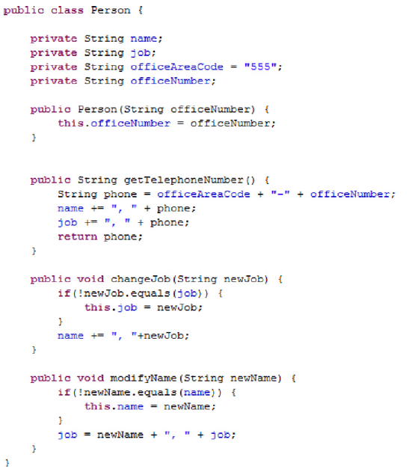
An illustrative example
Notes:
类中包括了4个成员变量和3个成员函数

Slide 14

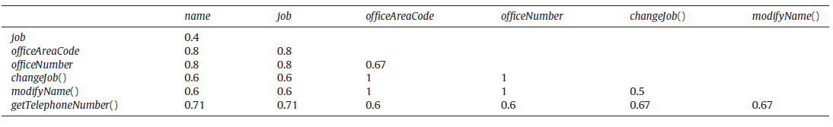
Distance metric
Get the entity set of each attribute and method
Calculate the Jaccard distance between two entities

Slide 15
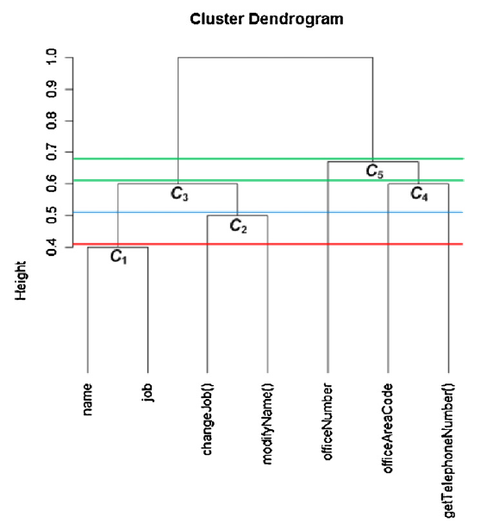
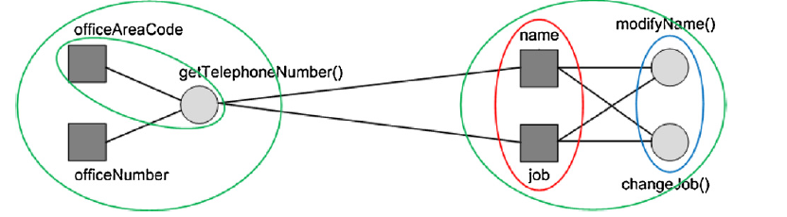
Clustering
Notes:
首先通过计算不同成员之间的distance来刻画它们之间的相似度，然后利用一种分层聚类的方法，可以得到右下角的聚类树状图，树状图的每一个连接点可以看作是聚类生成的一种抽象的概念(类型)，比如这里的C3和C5的连接点代表的是最顶层的一般性的类型，C1和C2可以看作C3的子类型，然后审视所有可以提取类的机会是否都是有必要的，比如这里的C1类只包含成员变量，所有我们并不把C1再提取一个类出来

Slide 16
Eliminating illegal candidate classes
Sufficient substantive functionality
The class to be extracted should contain more than one entity
The class to be extracted should contain at least one method
Behavior preservation
Abstract methods should not be extracted
Fields that have a visibility higher than private and are used by a class other than the source should not be extracted
Methods that override an abstract or a concrete method of the super class of the original class should not be extracted
The class to be extracted should not contain a method that makes any super method invocations.

Slide 17

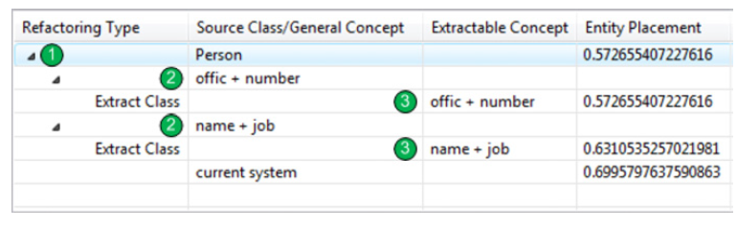
Rank candidate refactorings
Calculate the Entity Placement value and sort
Notes:
在生成了一系列的可以提取的概念之后，第一步，我们线去掉那些不满足预置条件的重构机会(C1)，然后C2重构也被抛弃了，因为重构C2类会导致系统的Entity Placement value值变高

Slide 18
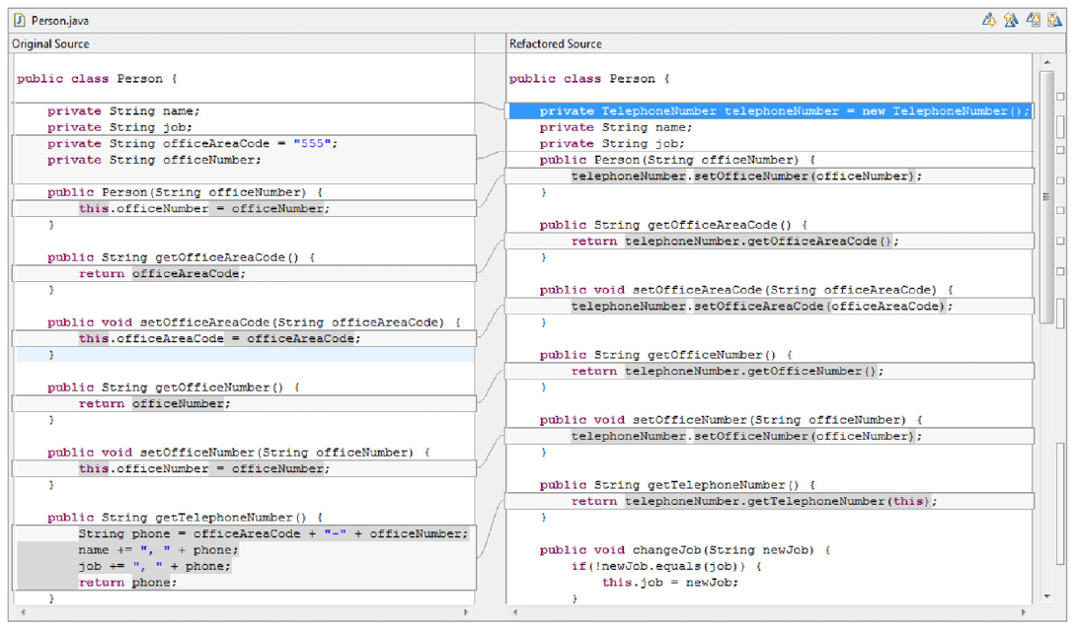
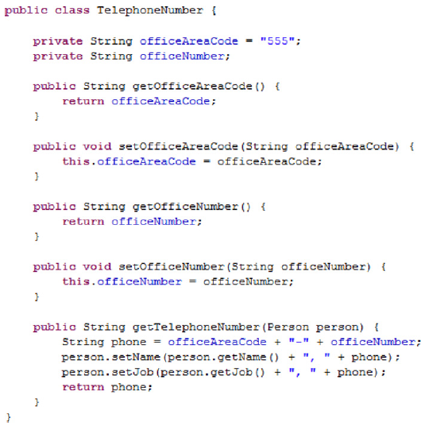
Refactor
Notes:
使用Eclipse的JDT来进行重构，首先从源码构建出AST，然后基于提取类的重构机制修改AST，然后重写代码

Slide 19
Conclusion
Introduce different types of code smell
Introduce different types of code smell detection approaches
Most approaches are based on distance metric

Slide 20
Q&A

